Slide 1

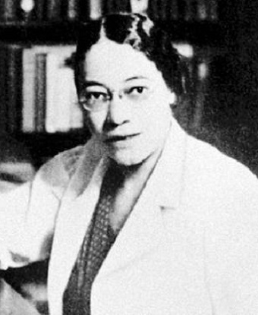
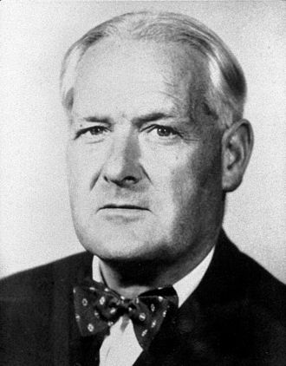


Basic R Skill-Building for Epidemiological Data Analysis
Sam Swift, PhD, MPH
Laura Tomedi, PhD, MPH

Slide 2
Welcome!
To get started, if you would like to follow along with the activities, please download R and R Studio
https://mirror.las.iastate.edu/CRAN/
https://www.rstudio.com/products/rstudio/download/#download
You can access access the slides, code, and resources presented
SamSwift505/TomediSwift_R_Training (github.com)

Slide 3
Lets find out who is in the audience
Say in chat what statistical program you have used
Do you have R downloaded?
Have you used R

Slide 4







Language &
Environment
Statistics
What is
FREE!
?
Community
Customizable
Online Training
https://www.r-project.org/
Notes:
R is a language and programming environment that can be used for statistical computing and graphics. It was developed by statisticians so it is particularly well suited for statistical analysis. It can also be used as a storage facility.
One big advantage of R is that it is open source so it is free
There is a large online community to support users
R is customizable using “packages” that can be downloaded as needed. R has over 10,000 packages in the Comprehensive R Archive Network (CRAN) repository.
There are a number of online trainings, manuals, and books that are freely available online to support users

Slide 5

There are Some Disadvantages to R
Can be less intuitive to learn then other programs
Updates require maintenance
Security
Can be slower than other languages
Some packages are not great quality
Memory management
Notes:
While there are many advantages to working in R, it is also important to note that there are some disadvantages

Slide 6
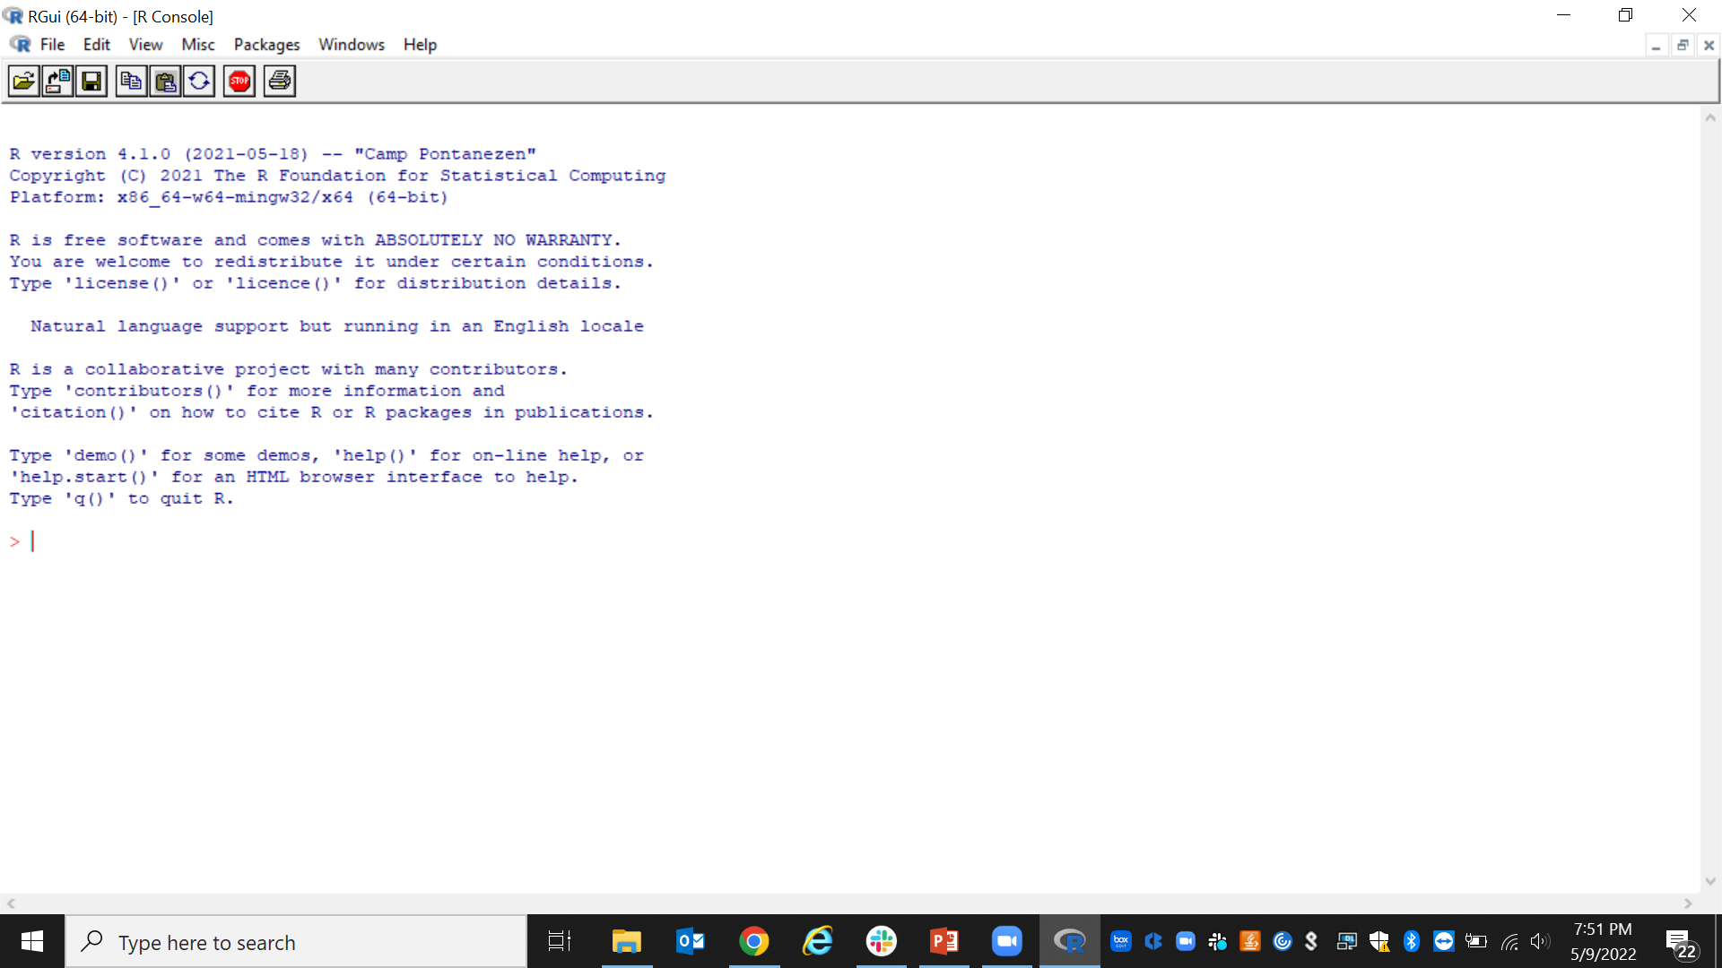
It is possible to work directly in the R Console, but it is clunky!
R Studio is an integrated development environment (IDE) that can be more user friendly

Slide 7
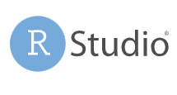
Plots
Code History
Auto-Completion
Code/Script Editor
Cheat- sheets
https://www.rstudio.com/

Slide 8
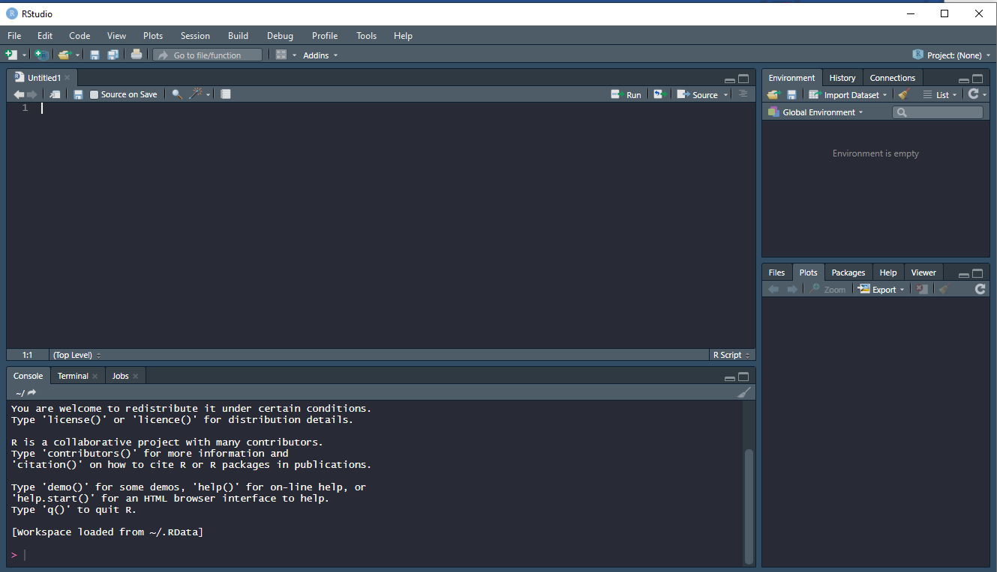
The script panel is where permanent programs can be saved
Objects you create will be saved here to the “global environment”
You can also freely code in the console here
Plots will appear here, also you can access packages and the help window from here

Slide 9
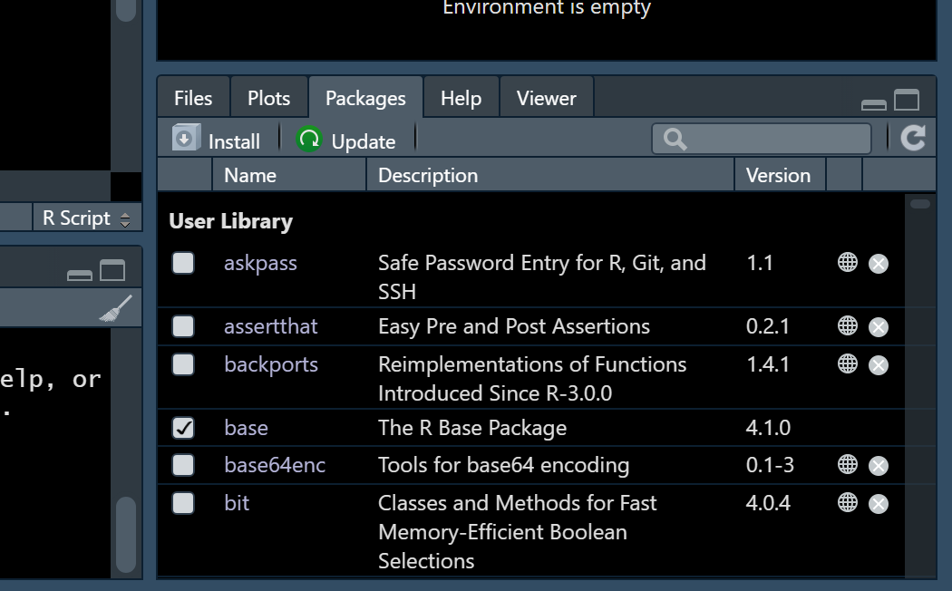
Downloading Packages
In the “packages” tab you can search for and download packages
You can also type:
install.packages("<package name>") into the console
Once the package is downloaded, the contents can be made available by using:
library("<package name>")

Slide 10

Commonly Used Packages
tidyverse: A collection of packages designed for data manipulation
dplyr: Shortcuts for sub-setting, summarizing, rearranging, and joining data
tidyr: Changing the layout of the data sets
stringr: Tools for regular expressions and character strings
lubridate: Makes working with dates and times easier
ggplot2: Create graphics
R Markdown: Can be used for automated reporting. Reports can be exported as HTML, pdf, or MS Word document

Slide 11
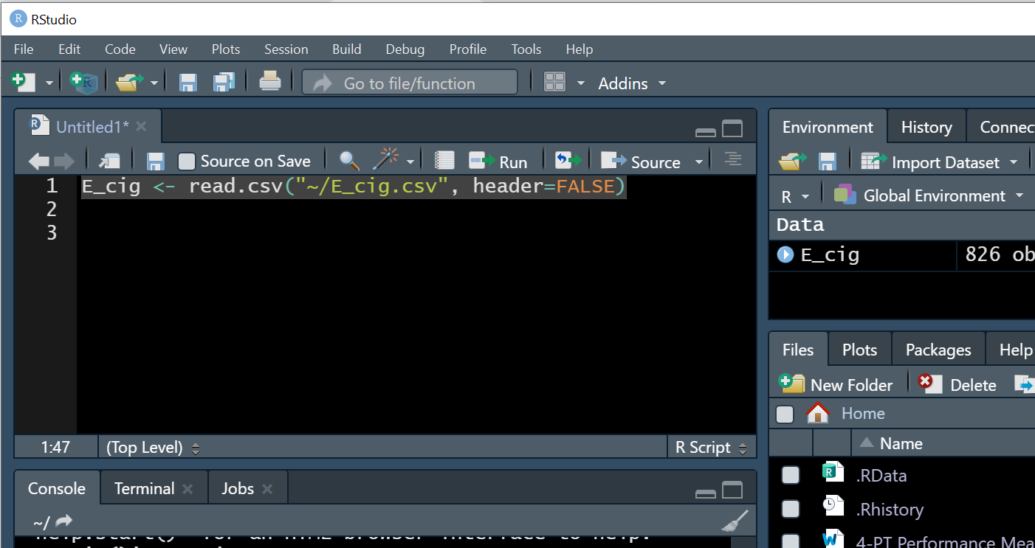
Reading in Text Data Sets
Use read.csv() to read CSV files and read.delim() for delimited text data
Assumes the first row is variable names – otherwise use the argument header=FALSE.
data <- read.csv("/path/to/file.csv")
data <- read.delim("/path/to/file.txt", sep="\t")
You can either code it into the script panel or free code it into the console. You can also view the data by clicking the created object

Slide 12
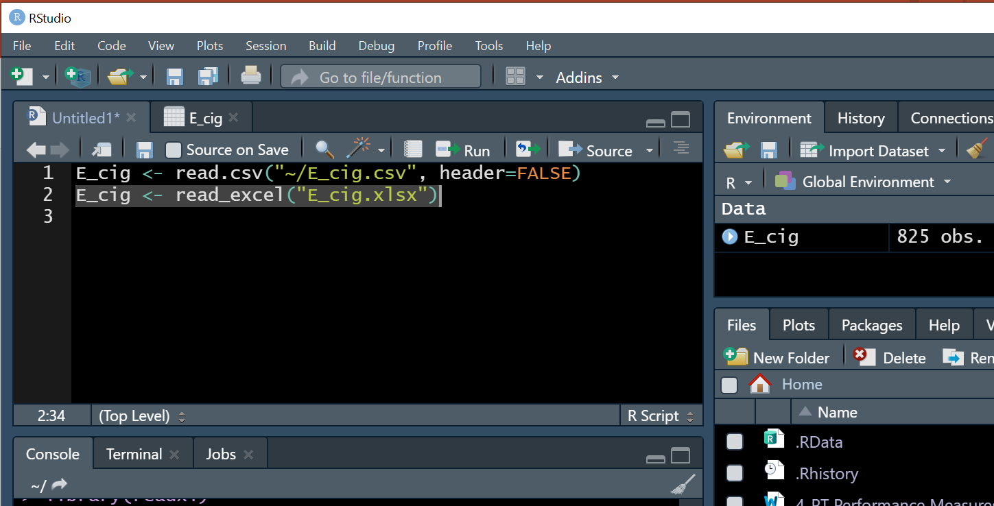
Reading in Excel Data Sets
You will need a package (e.g., readxl)
Use read_excel() to read .xlsx files
data <- read.excel("/path/to/file.xlsx")
You can either code it into the script panel or free code it into the console. You can also view the data by clicking the created object. (Or use the “Import Dataset” button for click and point)

Slide 13
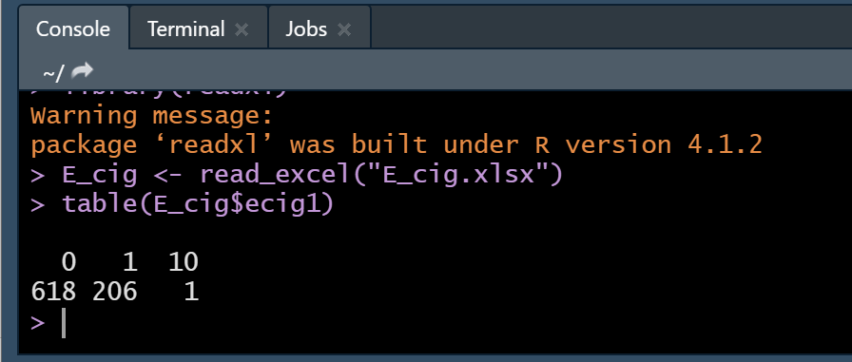
Identifying and Correcting Data Errors
Example: In the E_cig dataset, fake participants were asked if they currently used electronic cigarettes (ecig1). Response options were “Yes” (1) or “No” (0). You want to check that the variable was collected correctly
You can use table() or prop.table() to create a frequency table of a numeric categorical or binary variable
table(E_cig$ecig1)
There is one observation (“10”) that is out of the correct value range (0,1)

Slide 14
How Would You Identify Other Errors?
How do you identify missing values (“N/A” in R)?
How to check for skip pattern?
Some variables have “9” for missing and some have “N/A”. How would you change this?
The fake survey was conducted among 18-24 year olds. How can we check this?
Let’s practice!

Slide 15
Part 2- merging data, using a package, looking for help, and visualizing data
Sam Swift, PhD, MPH

Slide 16
Section contents
Understand how to merge two files together
Know where to find some resources to help build additional skills
Use a package to calculate basic statistics
Basic data visualization in R

Slide 17
Merging two files together- the basics
Unique_ID | Hat
1 | Stetson
4 | Ballcap
6 | Top hat
8 | Pirate hat
Unique_ID | Accessory
4 | Hot dog
6 | Monocle
8 | Parrot
1 | Horse
Unique_ID | Hat | Accessory
1 | Stetson | Horse
4 | Ballcap | Hot dog
6 | Top hat | Monocle
8 | Pirate hat | Parrot

Slide 18
Ingredients needed
2 (or more!) datasets
Unique identifier to merge datasets
Unique identifiers must be formatted the same!

Slide 19
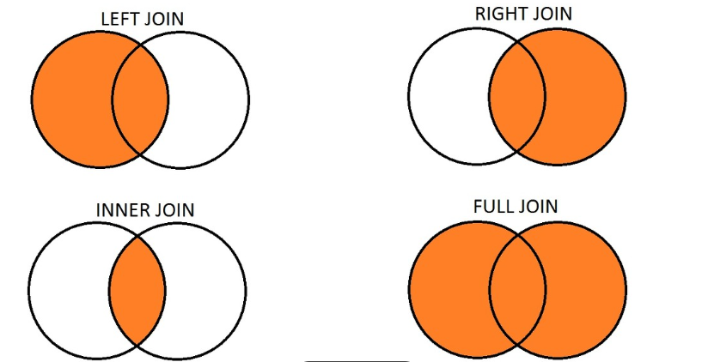

Types of joins in statistical software
Also called outer join

Slide 20
The code
Joined_data <- inner_join(ecig, active, by=c("id" = "id"))
Joined dataset
Dataset #1
Unique IDs- present in both datasets
Type of join
Dataset #2

Slide 21
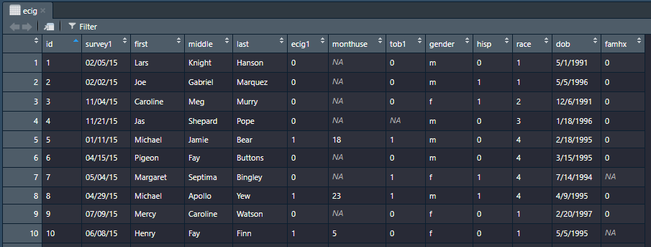
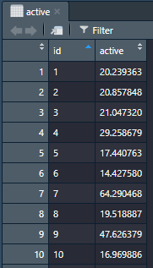
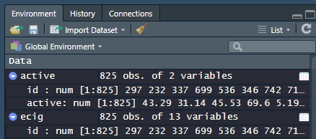
The data
Formatted the same in the global environment

Slide 22
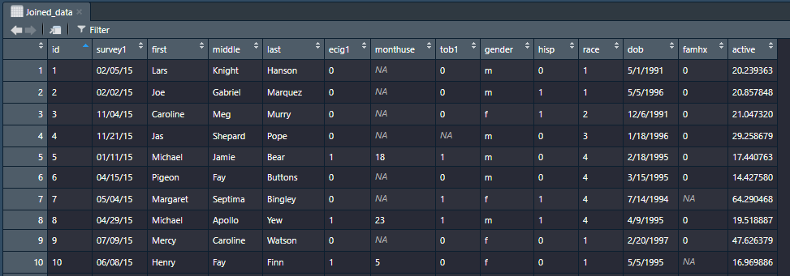

The result

Slide 23

Code demonstration interlude..

Slide 24
Where to find help/ resources
Resources for troubleshooting
Help menu
Using code to ask for help
Search engine (duckduckgo, bing, google)
Stack exchange
Resources for learning
R swirl
Coursera
YouTube

Slide 25

Help Menu
Go to this panel and click on “help”

Slide 26
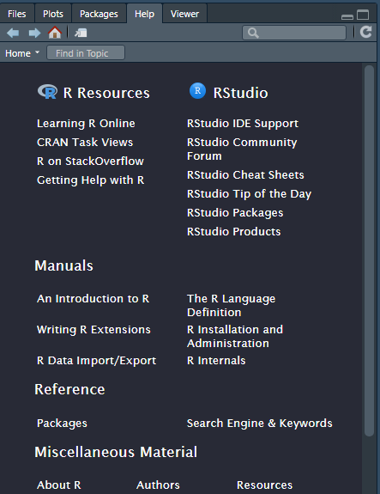
Help Menu
You can search for documentation on specific packages here
Tons of other information in home page of help menu here

Slide 27
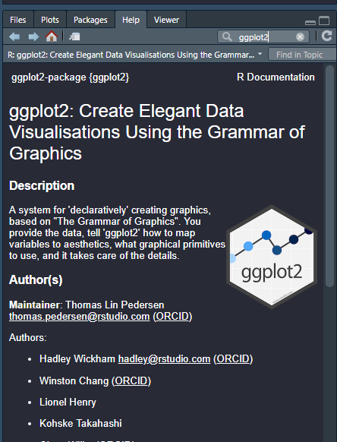
Using code to ask for help
#where to find help with packages
help(ggplot2)
help(epitools)
This also works:
??ggplot2

Slide 28
Resources for learning R
swirl: Learn R, in R. (swirlstats.com)
Introduction to R Online Course | DataCamp
Data Science: Foundations using R | Coursera
Introduction to R (1) (ucla.edu)

Slide 29
Code demonstration interlude..

Slide 30
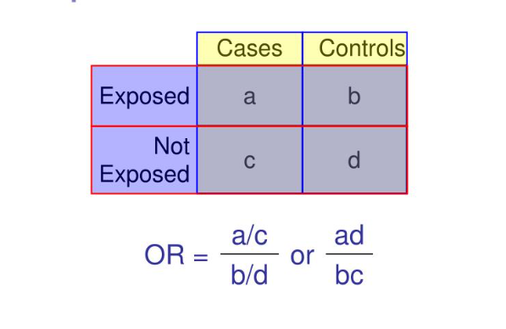
Calculate some basic statistics using a package
We will be using epitools package
To install it run the following:
This package allows us to calculate Odds Ratio and Relative risk for a contingency table
Install.packages("epitools")
library(epitools)

Slide 31
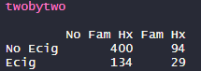
Create a table looking at e cigarette use by family history
Code:
twobytwo<-table(ecig$ecig1,ecig$famhx)
Column Variable
Row variable
Resulting Object (table)
Function to make table
Resulting table after formatting

Slide 32
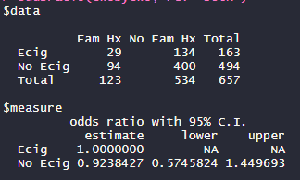
Epitools package
Can give us odds ratio, relative risk and many other statistics
No documentation in R help- but there is information online
Code:
oddsratio(twobytwo, rev="both")
Result
Function
Special option
Object we made

Slide 33
Code demonstration interlude..

Slide 34
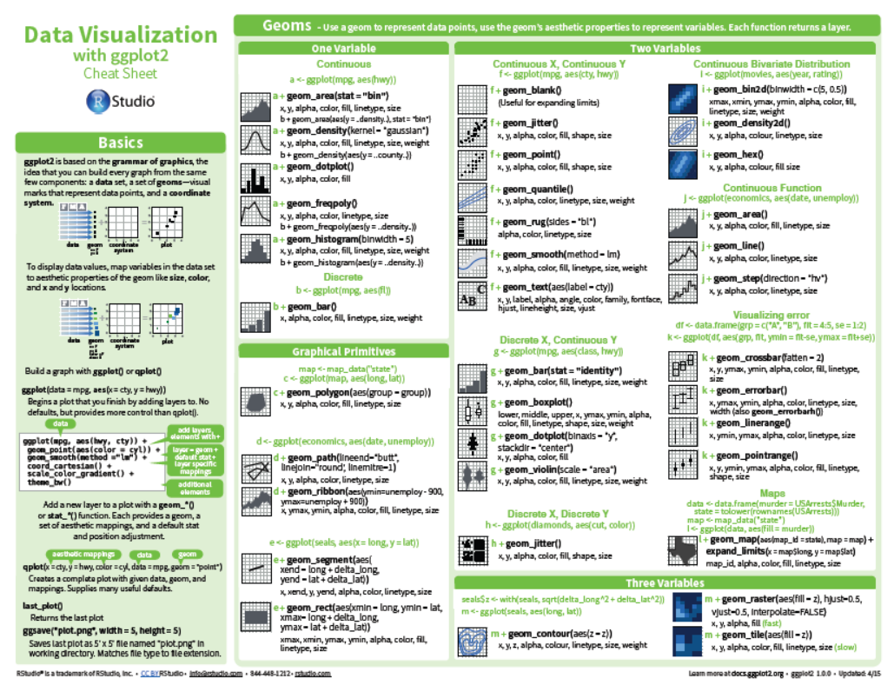
(Very) basic data visualization using ggplot2
ggplot2 is iterative
Search engines are friends
Cheat sheets are very helpful

Slide 35
Basic code
p <- ggplot(plotdata, aes(y=mean, x=ecig)) + geom_bar(stat="identity")
Name of dataset we are plotting
Variables for X and Y axis
Object we are making (a graph!)
Type of graph we are making (bar graph)

Slide 36
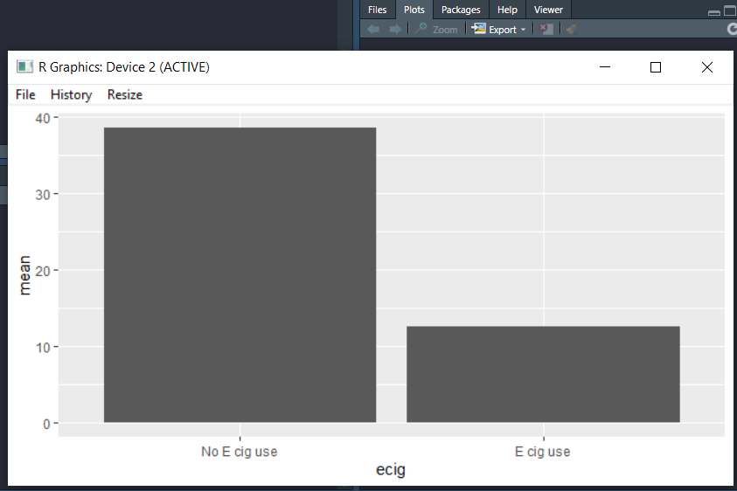
Once done, call the plot and it pops up in the “plots” window
p <- ggplot(plotdata, aes(y=mean, x=ecig)) + geom_bar(stat="identity")
p

Slide 37
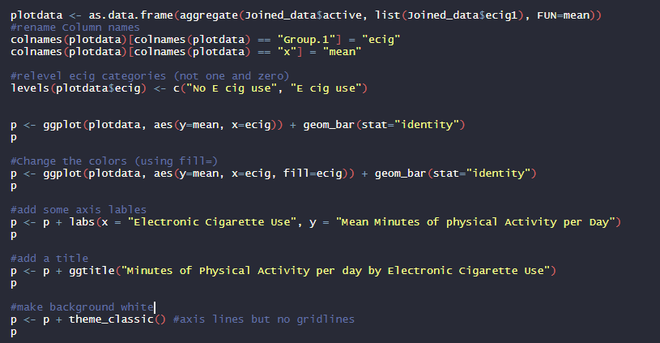
That graph looks bad!
Let’s see why ggplot2 is “an iterative” process- each iteration fixes a problem with graph

Slide 38
Code demonstration interlude..

Slide 39
Thanks so much for your participation!
Questions?
Samuell.swift@state.nm.us
ltomedi@salud.unm.edu

